Slide 1

(Management Topic in Environmental Studies) B. Tech 7TH Semester
Ecological succession
Ecosystem
Prepared by; Dr Naresh Kumar Sahoo
Department: Chemistry
Subject: MTES (CHM2049)

Slide 2
Contents
Introduction to Ecological succession
Type of Ecological Succession
General Process of Ecological Succession
Primary Succession
Secondary Succession
Difference between primary and secondary succession
Physical factors involving in ecological succession
Threats to Climax Communities

Slide 3
Definition:
Ecological succession: is defined as an orderly process of changes in the community structure and function with time mediated through modifications in the physical environment (climate) and ultimately culminating in a stabilized ecosystem known as climax.
The gradual replacement of one plant community by another through natural processes over time

Slide 4
Classification based on different types of areas
Ecological successions starting on different types of areas or substrata are named differently as follows:
(i) Hydrarch or Hydrosere: Starting in watery area like pond, swamp, bog
(ii) Mesarch: starting in an area of adequate moisture.
(iii) Xerarch or Xerosere: Starting in a dry area with little moisture.
Lithosere : starting on a bare rock
Psammosere : starting on sand
Halosere : starting on saline soil

Slide 5
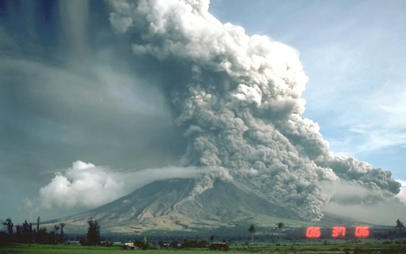
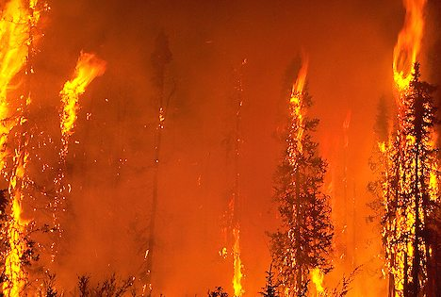
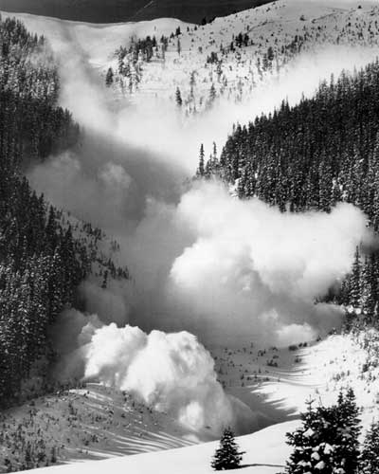
Process of Succession
Sequential steps of Ecological succession :
(i) Nudation: Start from bare area/land without any life form.
The bare area may be caused due to landslides, volcanic eruption , drought, glaciers etc. overgrazing, disease outbreak, agricultural/industrial activities.
(ii) Invasion: It is the successful establishment of one or more
species on a bare area due to dispersal of the seeds, spores by wind, water, insects or birds. Then the seeds germinate and grow on the land as pioneer species.

Slide 6
Process of Succession
iii) Competition and Co-action: As the number of individuals grows there is competition for space, water and nutrition. both inter-specific (between different species) and intra-specific (within the same species),
They influence each other in a number of ways, known as co-action
(iv) Reaction: The living organisms grow, use water and nutrients from the substratum, and in turn, they have a strong influence and modified the environment known as reaction.
The modifications are very often unsuitable for the existing species and favour some new species.
(v) Stabilization: The succession ultimately culminates in a more or less stable community called climax
The climax community is characterized by maximum biomass and symbiotic relationship

Slide 7
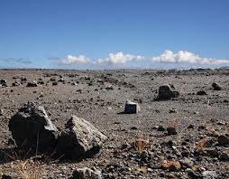
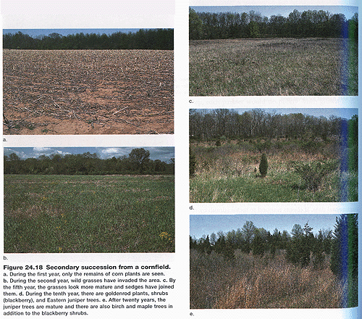
There are two main types of Ecological Succession
Primary Succession: The process of creating
life in an area where no life previously existed.
Volcano, Rock, Desert, drought, glaciers
New lava or rock from a volcano
Secondary Succession:
The process of re-stabilization/ re-growth after a disturbance in an area with existing soil where life has formed again an ecosystem. Example Corn field
Corn field

Slide 8
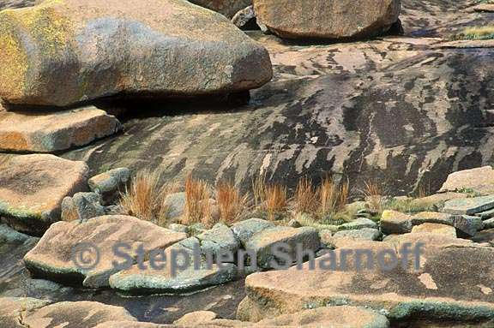
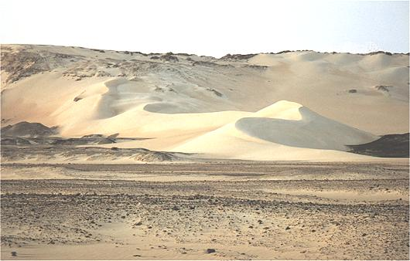
Primary Succession
The development of an ecosystem in an area in which a community has never lived before, would be a new lava or rock from a volcano that makes a new island.
No soil, there is no Nutrient
and community

Slide 9
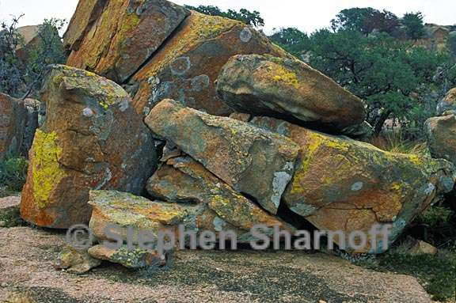
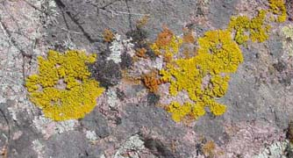
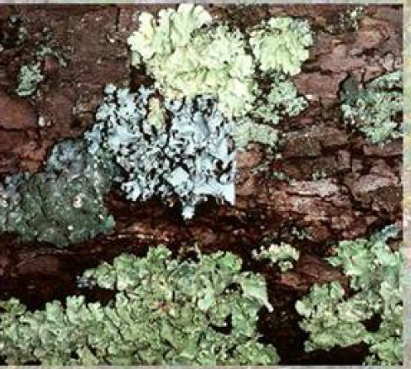
Primary Succession
Lichens begin growing on the rocks. Over many years lichens produce acid and break down rock into sand.
Weathering and erosion break down rock into sand.
Lichens that do not need soil and grow in dry condition to survive Called PIONEER SPECIES

Slide 10
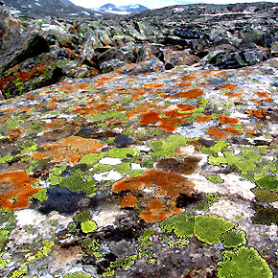
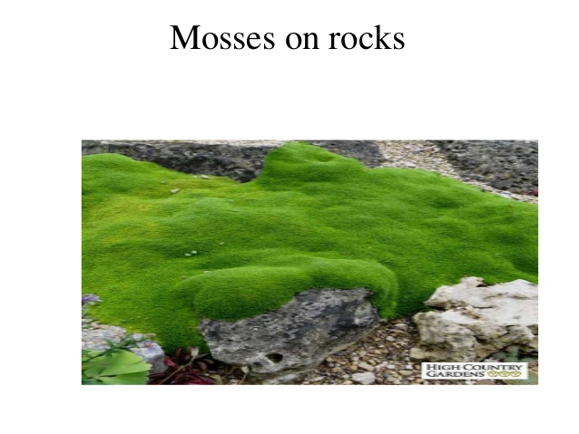
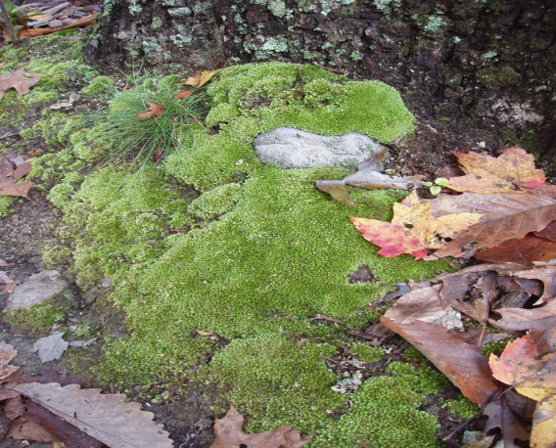
Primary Succession
Lichens grow larger. And death decompose of lichen increases the organic content of the sand with organic content. Nitrogen cycle begins. Eventually enough nutrients enter the sand and it becomes soil.
Seeds are blown in by the wind or carried in by animals.
Simple plants like mosses can grow in the new soil The plants grow and the soil gets enriched as plants die..

Slide 11
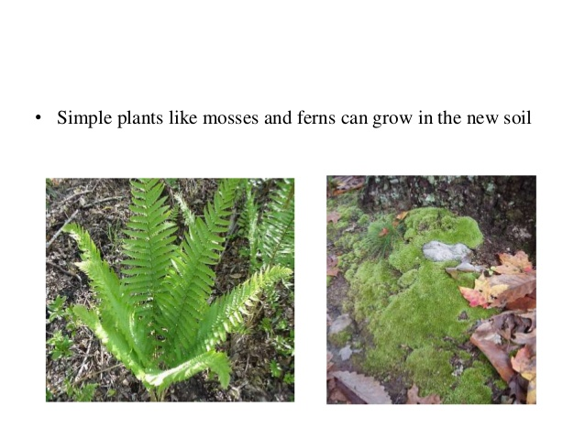
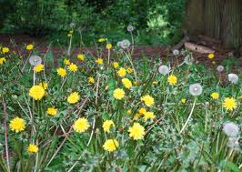
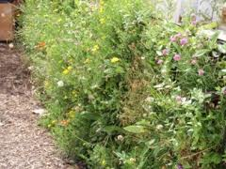
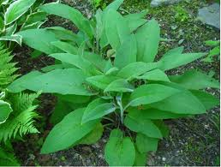
Primary Succession
Fern,Herbs and weeds can grow in the thicker, enriched soil
Mosses and fern
can grow on new soil
The herbs and weeds plants die, adding more organic material. The soil layer thickens, and grasses, wildflowers, and other plants begin to take over

Slide 12
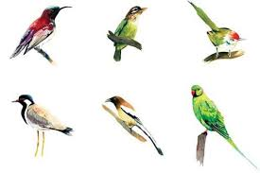
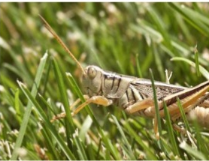
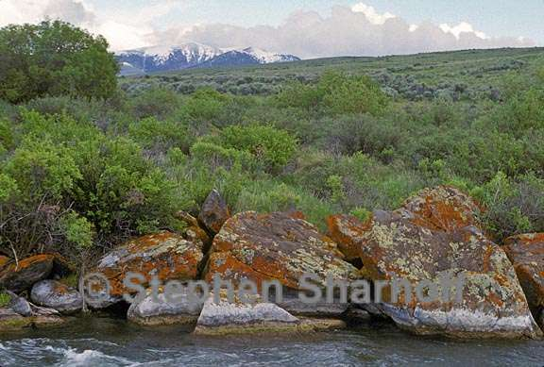
Primary Succession
Insects and small birds
make this their habitat.
The vegetation grows closer together, reducing the amount of space available for growing.
Competition between lichen and shrubs for the same space.
Eventually one species (lichen) will die out (or move) and the other species will survive (shrubs).

Slide 13
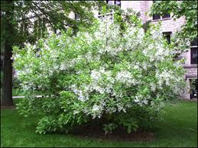
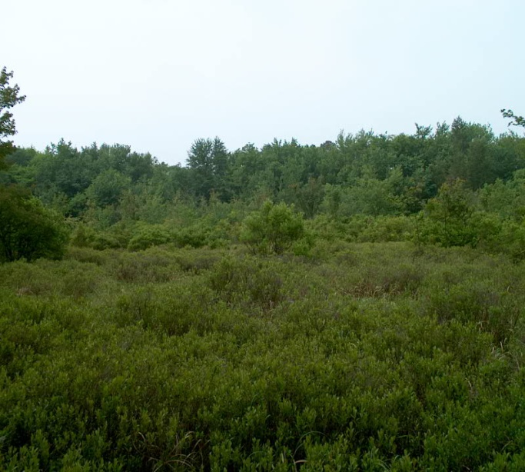
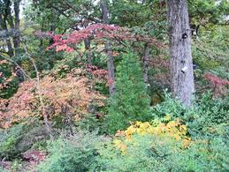
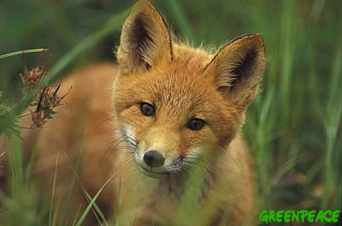
Primary Succession
These plants die, and they add more nutrients to the soil
Shrubs and tress can survive now
Mammals have begun to move in
What was once bare rock now supports a variety of life

Slide 14
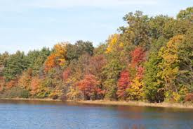
Primary Succession
These plants die, and they add more nutrients to the soil
Now larger trees can grow: Beech, Oak, Walnut, Maple…
The Climax Community
A climax community is a mature, stable and best adapted community that is the final stage of ecological succession.

Slide 15

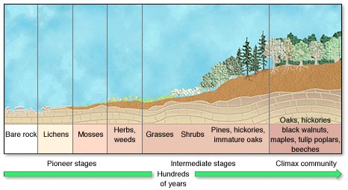

Slide 16
Secondary Succession
Organisms are destroyed but the soil is safe.
The soil already contains the seeds of weeds, grasses, and trees. More seeds are carried to the area by wind and birds.
Succession begins again but the primary species are different.
Because soil is present, this succession is faster.

Slide 17
Secondary Succession on an abandoned Cornfield

Slide 18
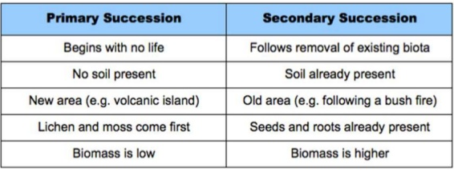
Difference between primary and
secondary succession

Slide 19
Physical factors involving in
ecological succession
The factors involved in ecological succession are either biotic or abiotic.
Abiotic factors.
i) Light. Sun Light affects living things in terms of intensity, quality and duration.
ii) Temperature.
iii) Atmospheric Pressure.
iv) Humidity.
v) Rain fall pattern
vi) Soil quality, moisture and organic content, its pH
vii) Wind flow
Humidity affects the rate at which water evaporates from the surface of organisms such as in transpiration or sweating.
Wind. etc.,

Slide 20
Threats to Climax Communities
Rapid urbanization and roads, railway tract
Mainlining activities
Industrial establishment
Demand of Wild life product and fuel
Deforestation for agricultural purposes
Construction of big Dams
Pest and wide spread diseases
Flooding and Volcanic eruptions
Forest Fires
Anything that destroys the existing community,

Slide 21
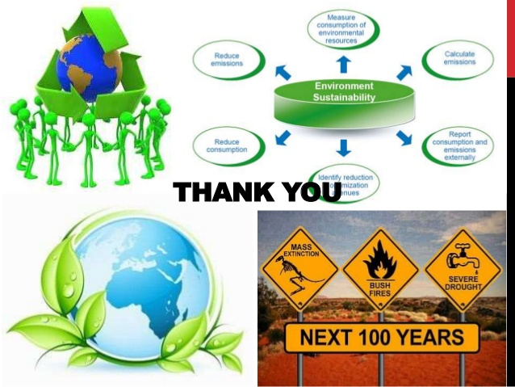
Methods of Forest Conservation
Regulated and Planned Cutting of Trees
Control over Forest Fire
Reforestation and Afforestation
Check over Forest Clearance for Agricultural Purposes
Protection of Forest
Proper Utilization of Forest Products and Forests

